Slide 1
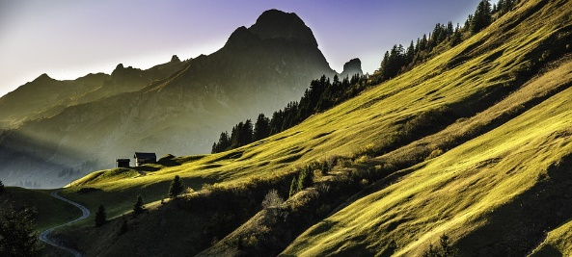
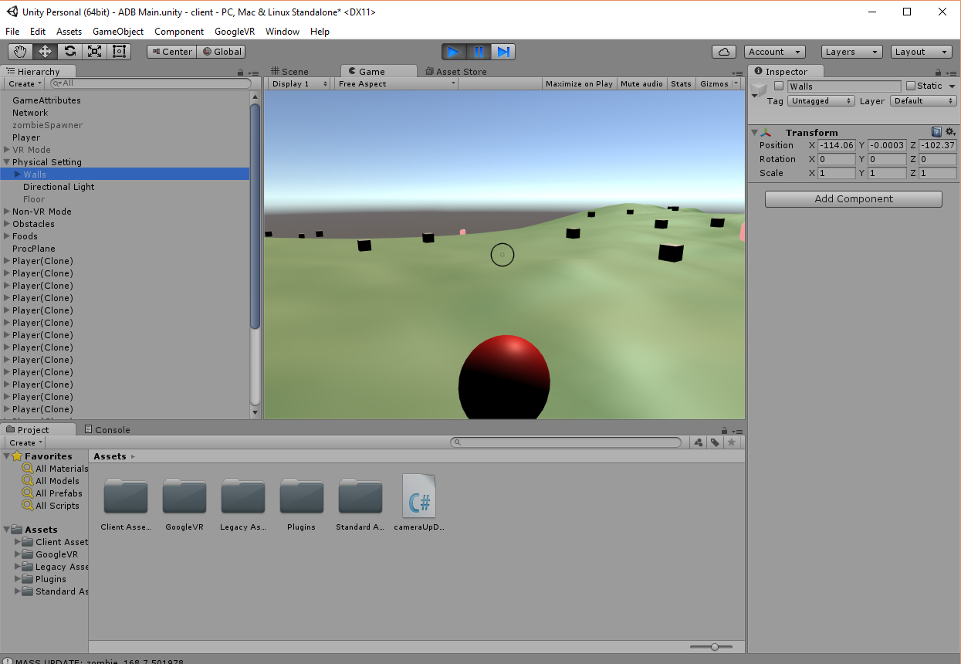



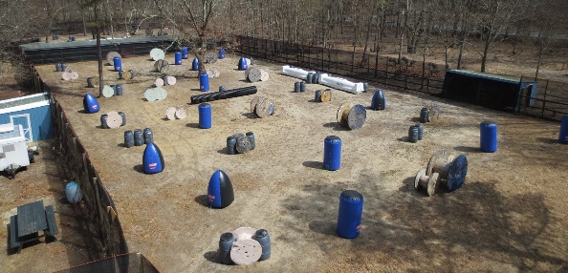
Landscape Service
Primary Server and
Movement Service
Unity Client
Data Service
Redis Server
Field Objects Service

